Slide 1

Quarantining – Not You, Your plants!

Slide 2
Questions
Have you ever exchanged plants with other members at a club meeting? (Raise your hand)
Have you ever won a plant in a raffle drawing at one of your club meetings? (Raise your hand)
Have you ever shown an African Violet plant, then brought it back home? Or exchanged leaves/plants with a violet buddy at the show? (Raise your hand)

Slide 3

Home
Now it’s time to get your new plants back home and introduce them to your current collection of plants.
Wait!
This Photo by Unknown Author is licensed under CC BY-NC-ND

Slide 4
Isolate
Always quarantine/isolate any new plant purchases/winnings from your other plants. No matter how reputable the vendors and/or your friends are, remember to quarantine/isolate your new plants.
Pick a separate area/room in your house away from your current established plants.

Slide 5
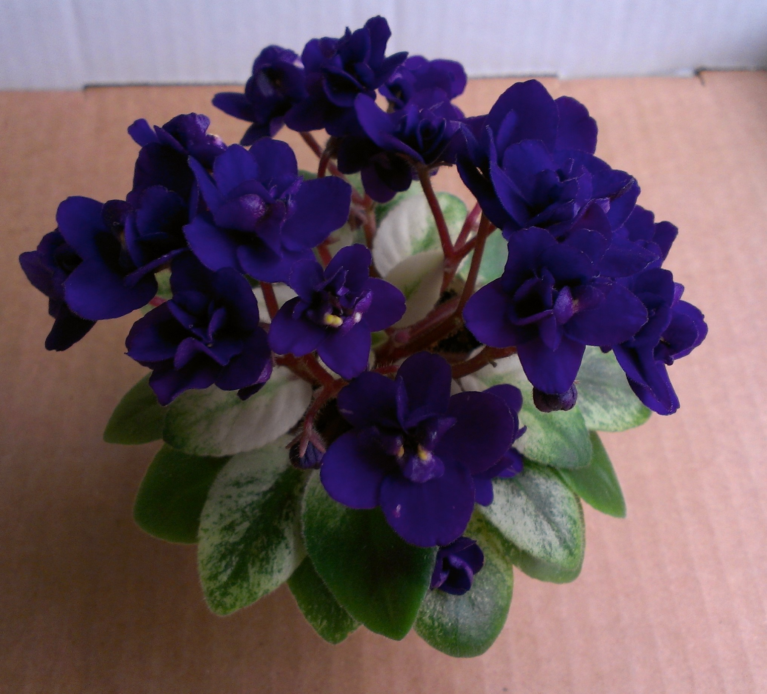
Where
When you have figured out what area you will keep your new plants (away from your established plants), then proceed as follows:
Remove all blooms and ugly/dead leaves and pitch. I know it’s difficult to remove blooms especially if that bloom looks good.

Slide 6
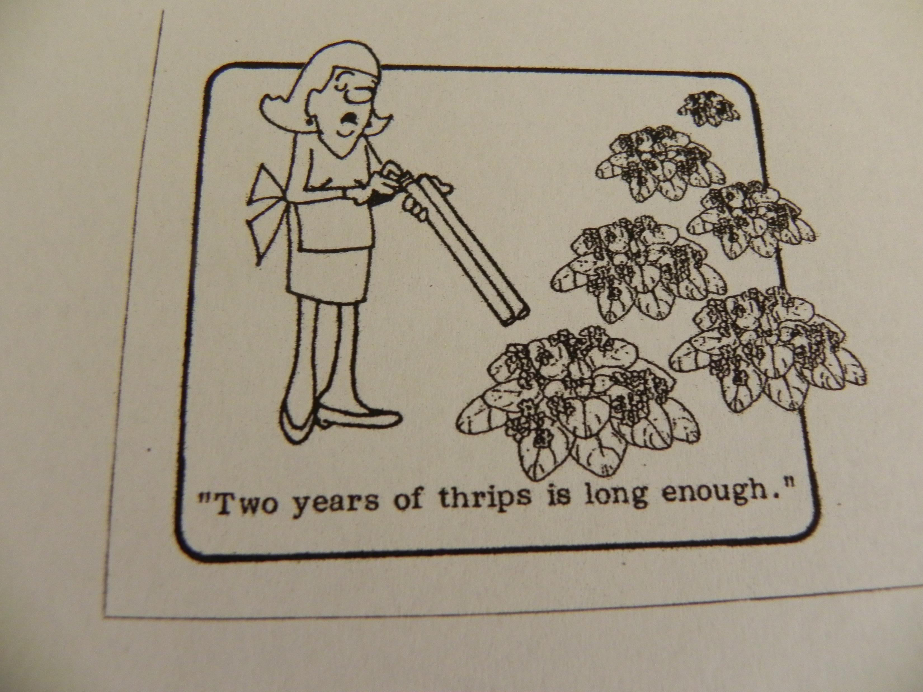
Precaution
Look for pests.
It is smart to be preventive beforehand instead of having to deal with your whole African Violet collection being infected.

Slide 7
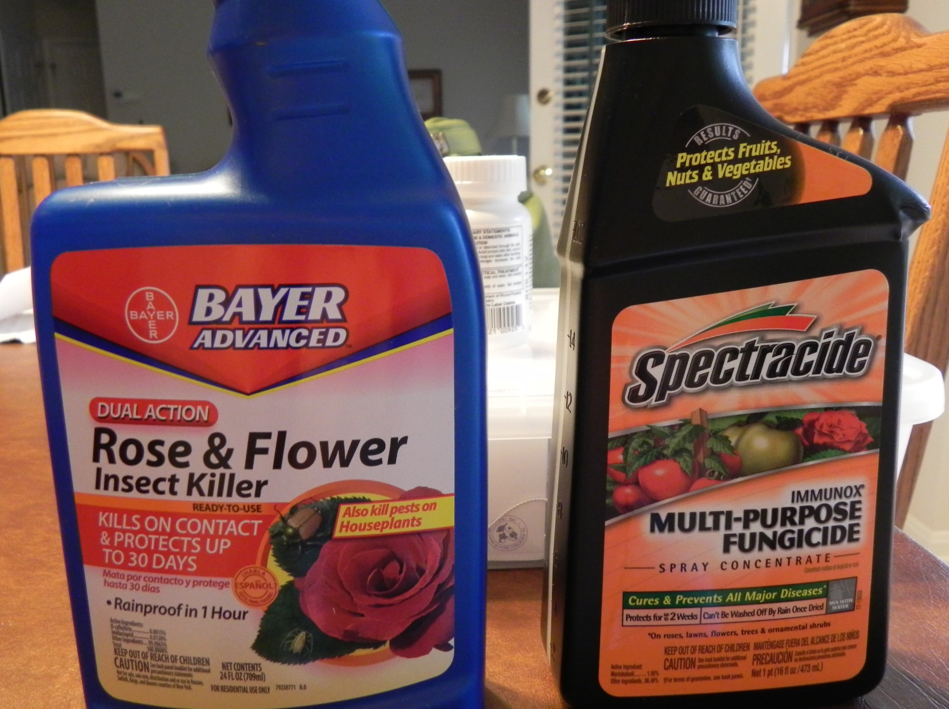
Spray
Once an infection occurs in one African Violet plant, it doesn’t take long for it to spread throughout your entire houseplant collection.
You can spray with an Insect Killer or Fungicide if you feel it necessary.
Of course, that may not be the case that the new African Violet plant you brought home is infected but its better to err on the side of caution.

Slide 8

Separate
Place each plant in a separate plastic bag or domed container. I have a plant stand in my isolation/spare bedroom that I can keep these containers on shelves.

Slide 9
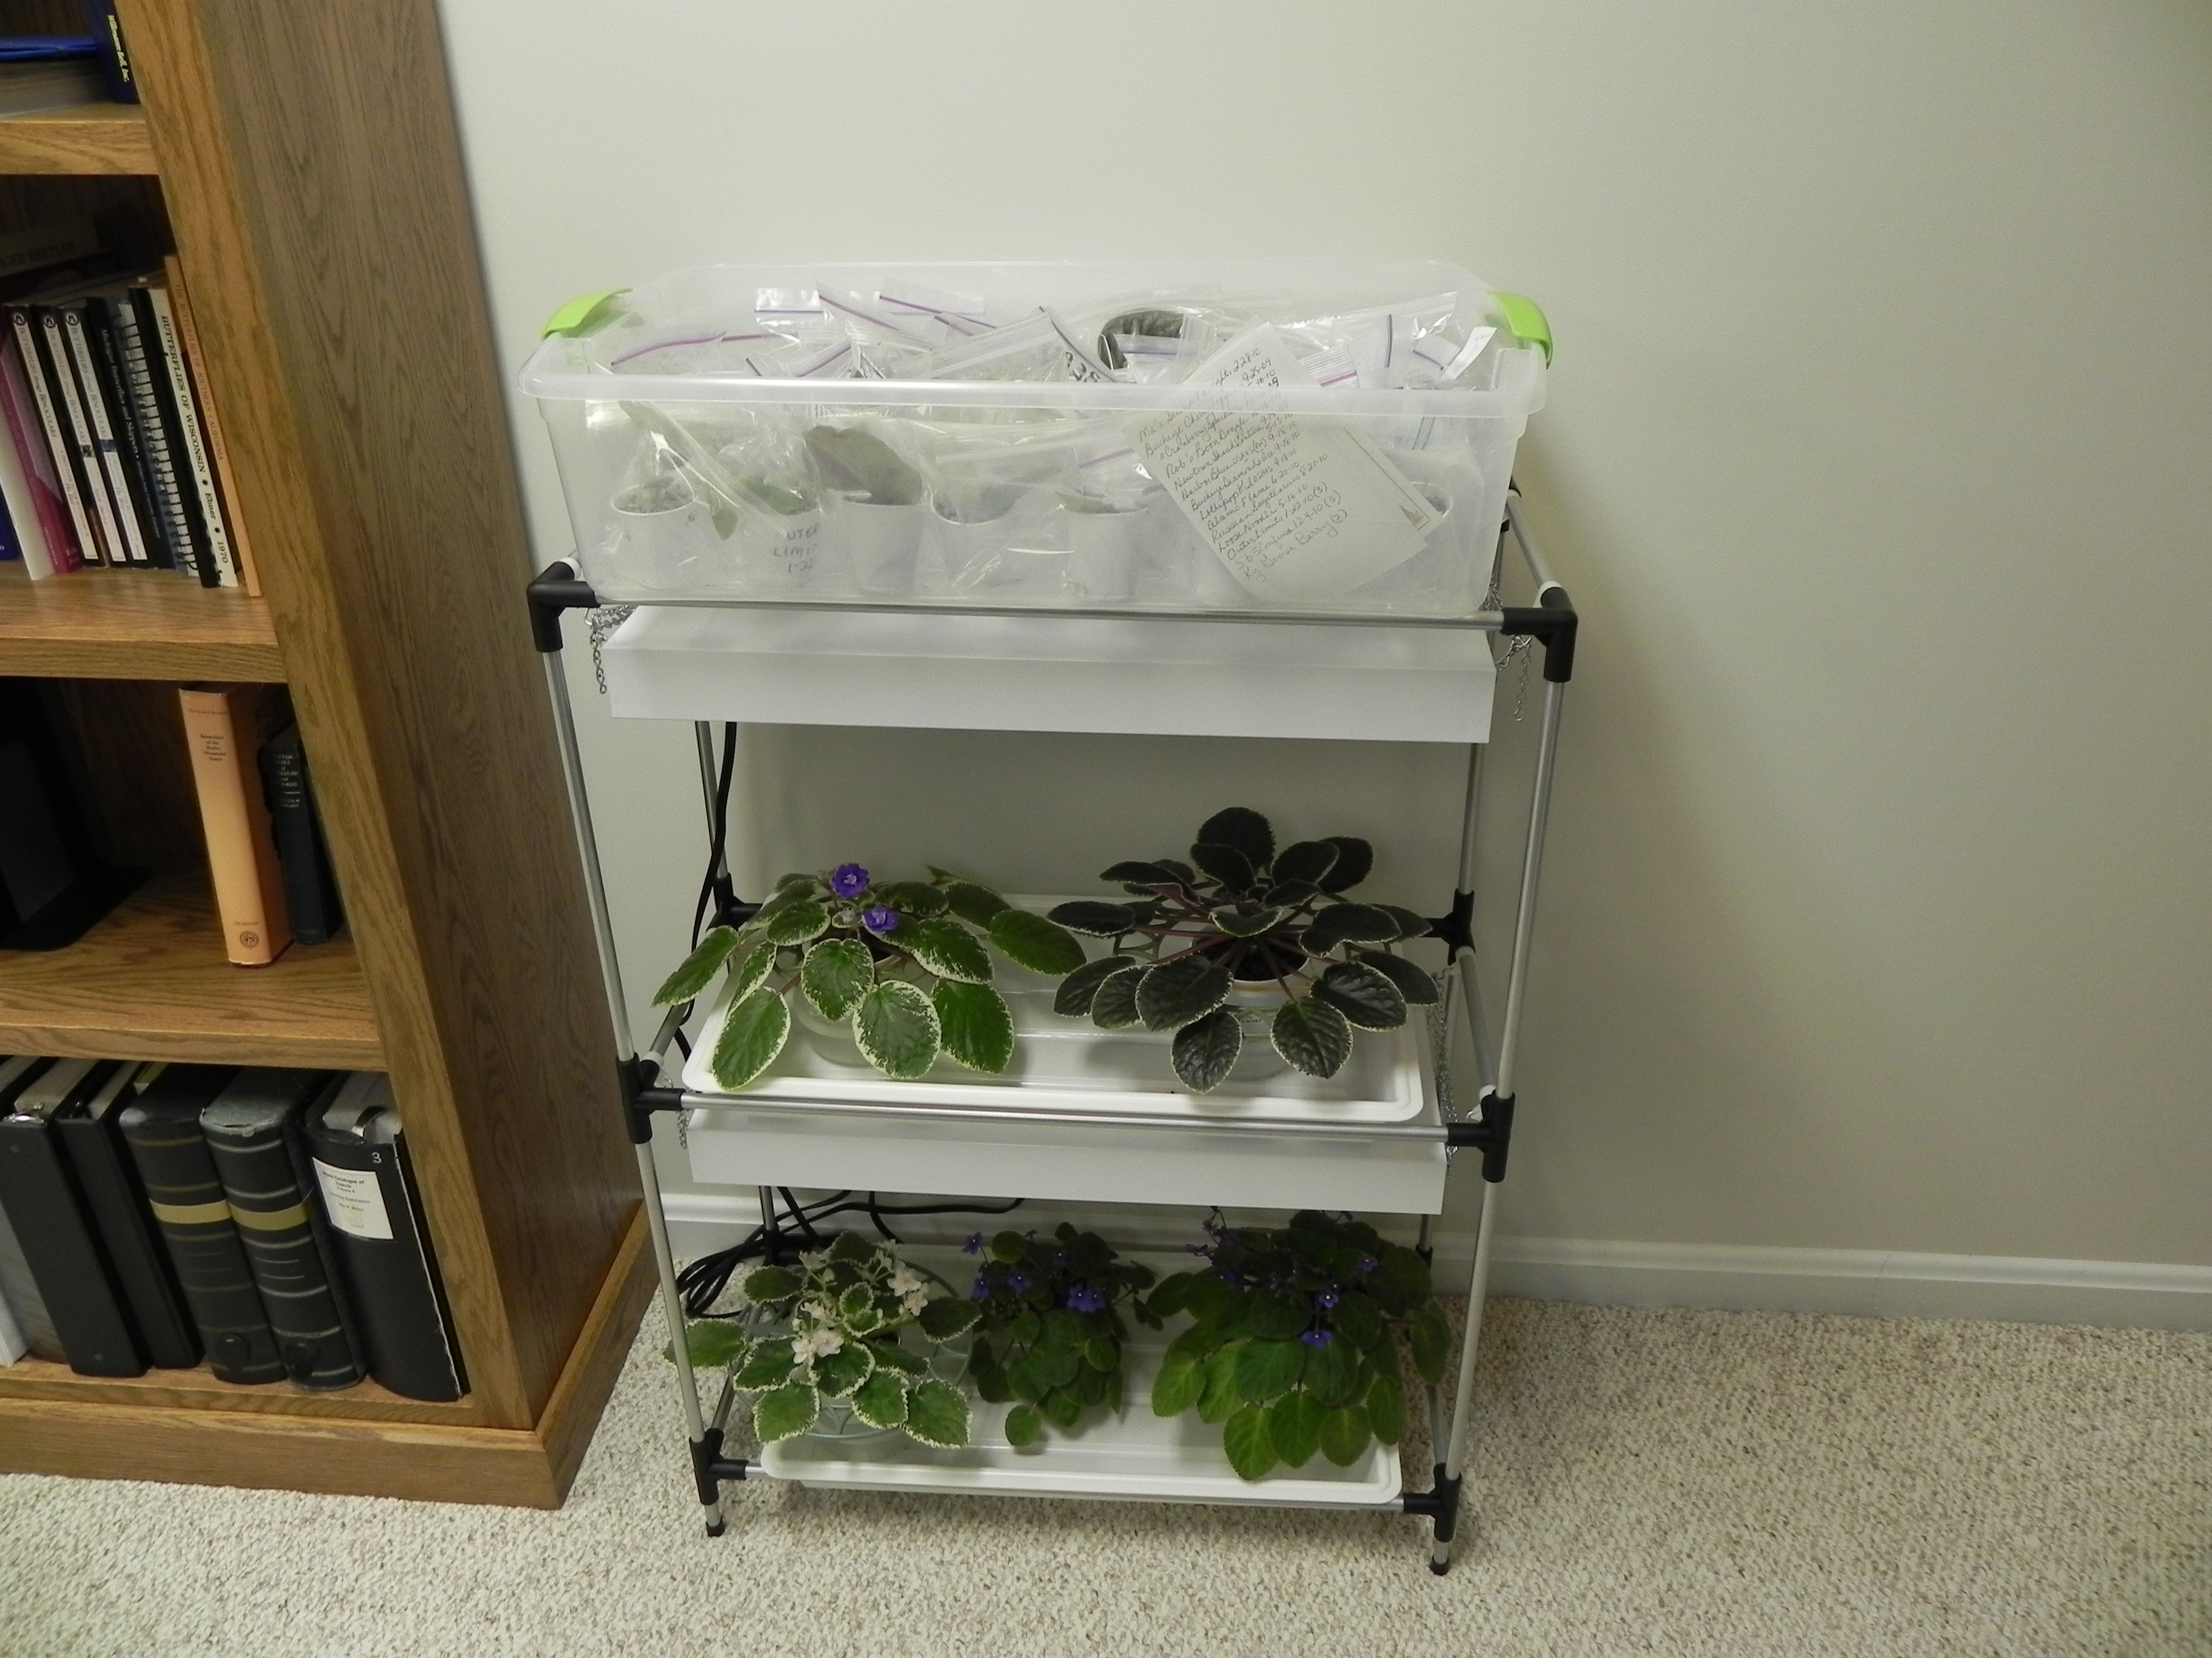
Isolated area
Isolate/quarantine for two months or longer depending on their progress.
Repot each plant before adding to your established collection.

Slide 10
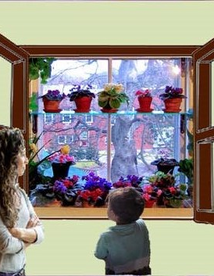
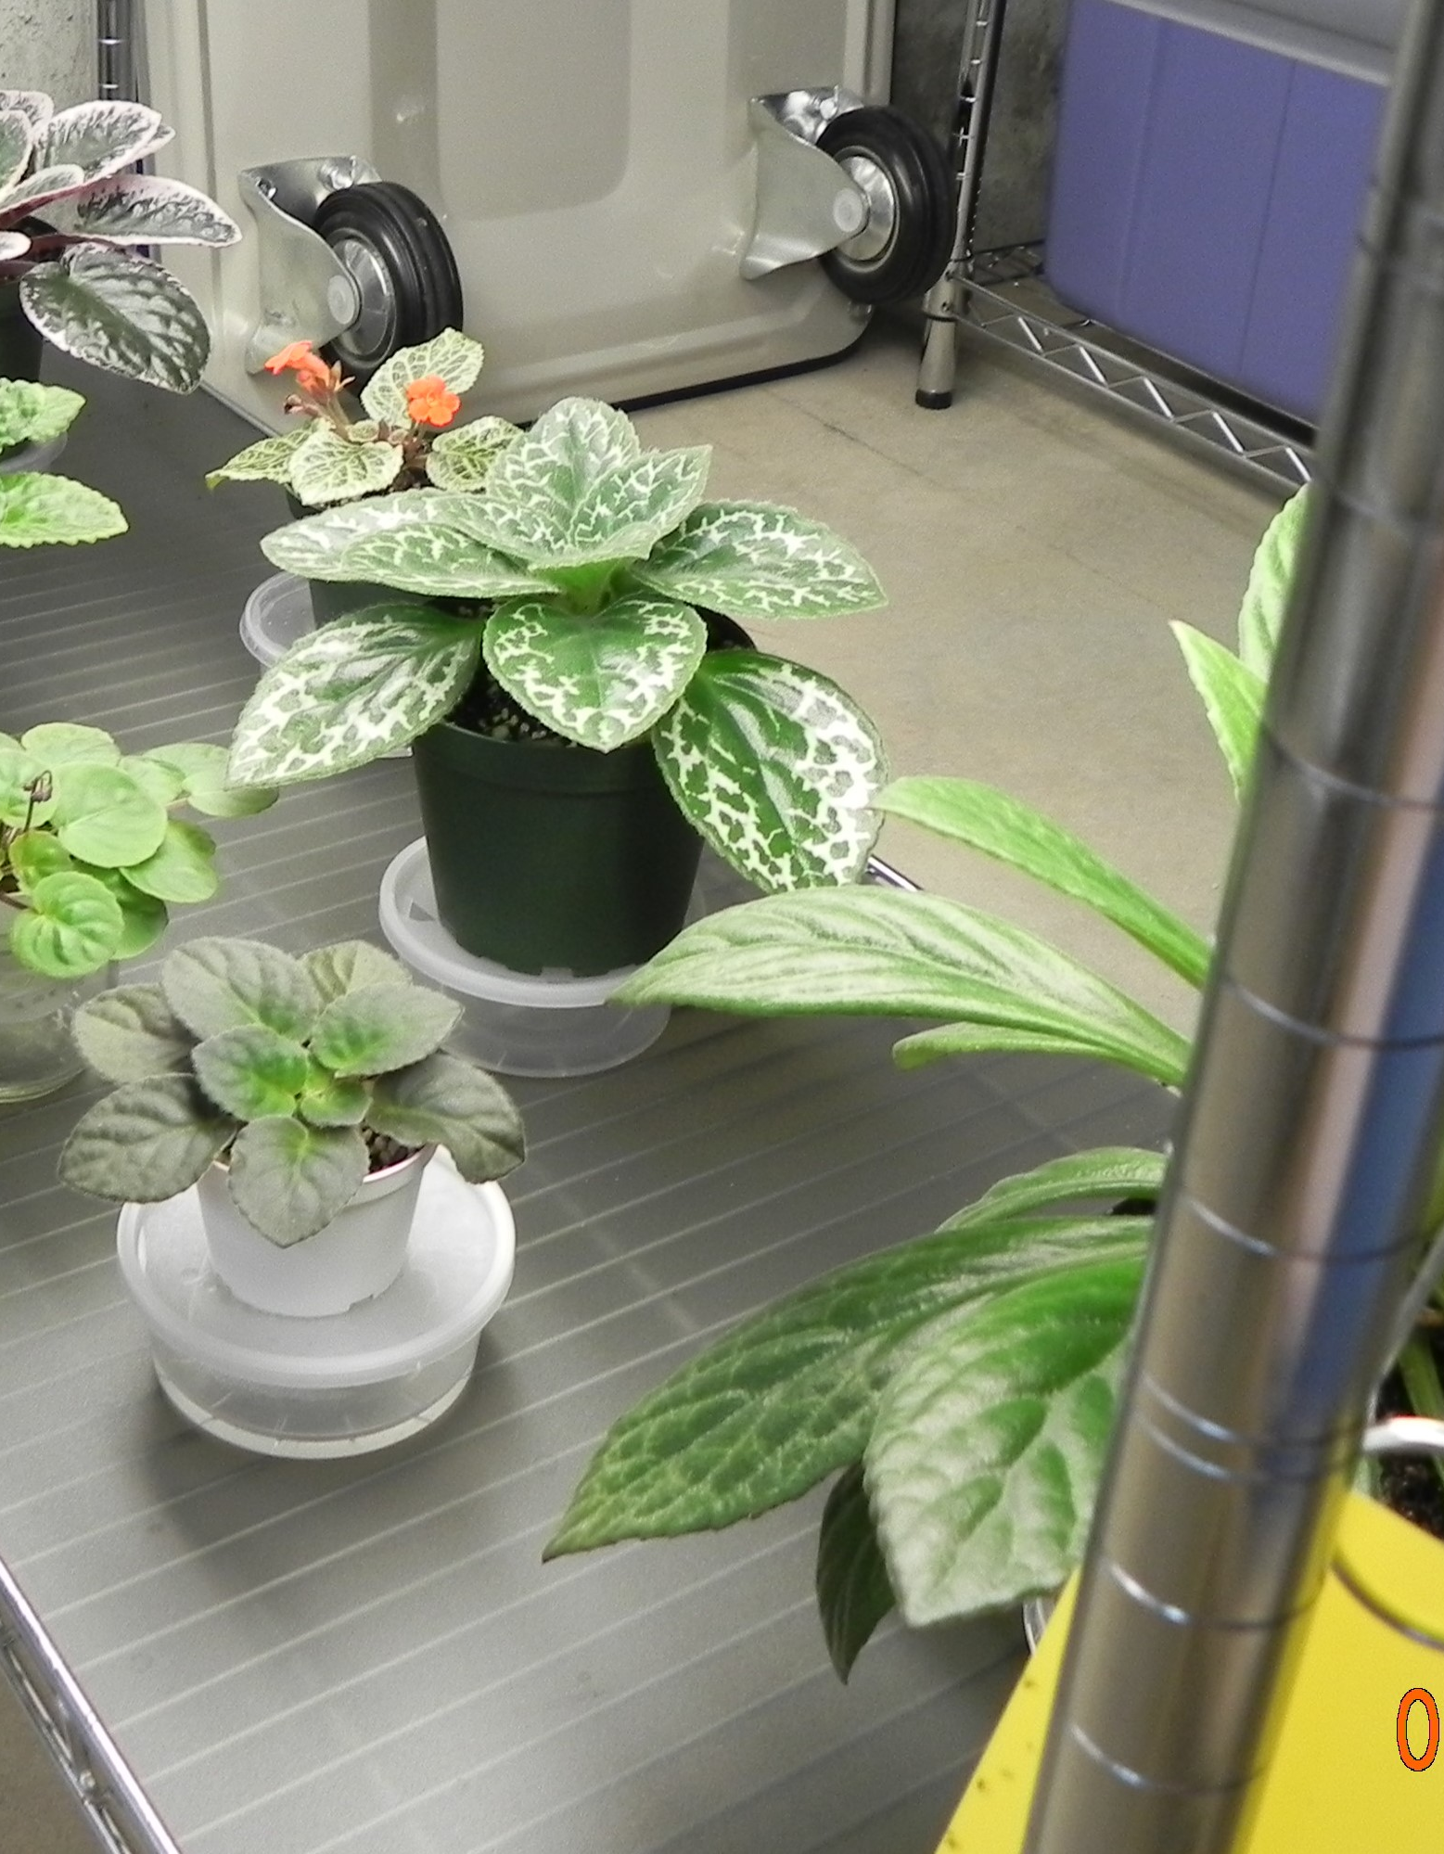
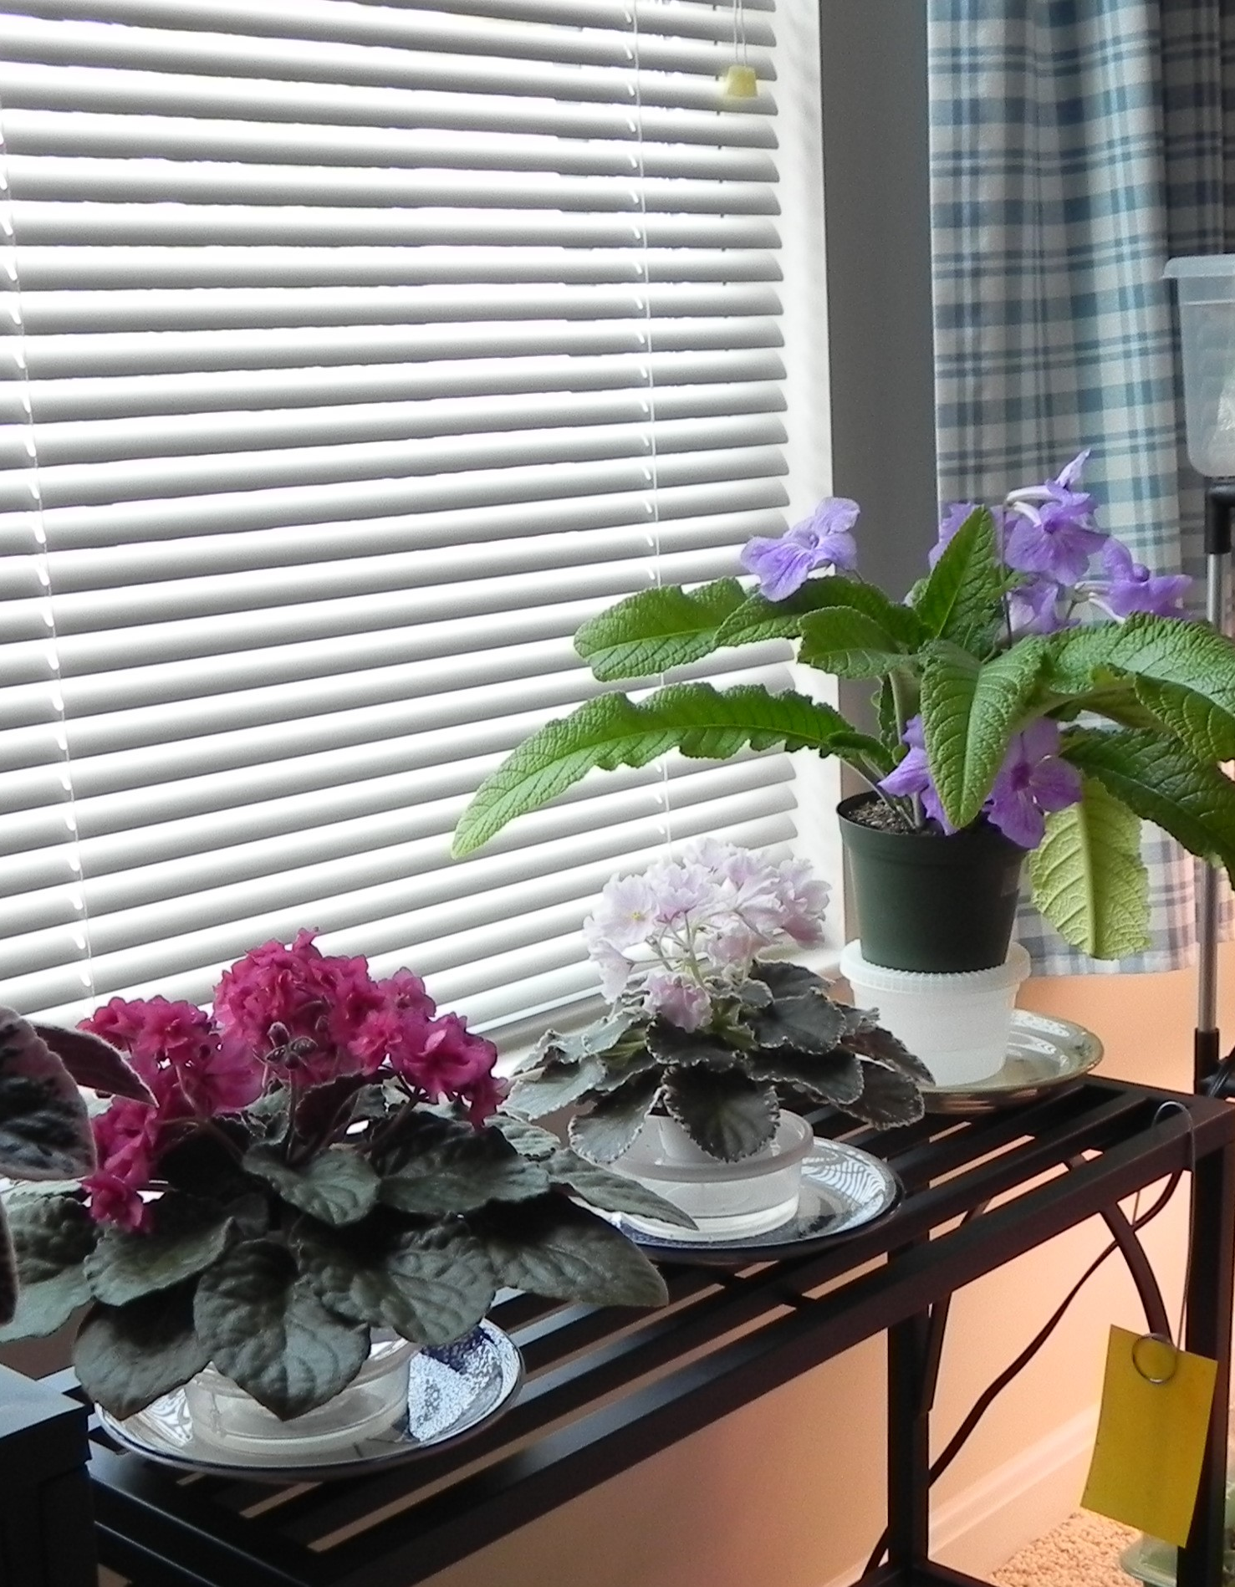
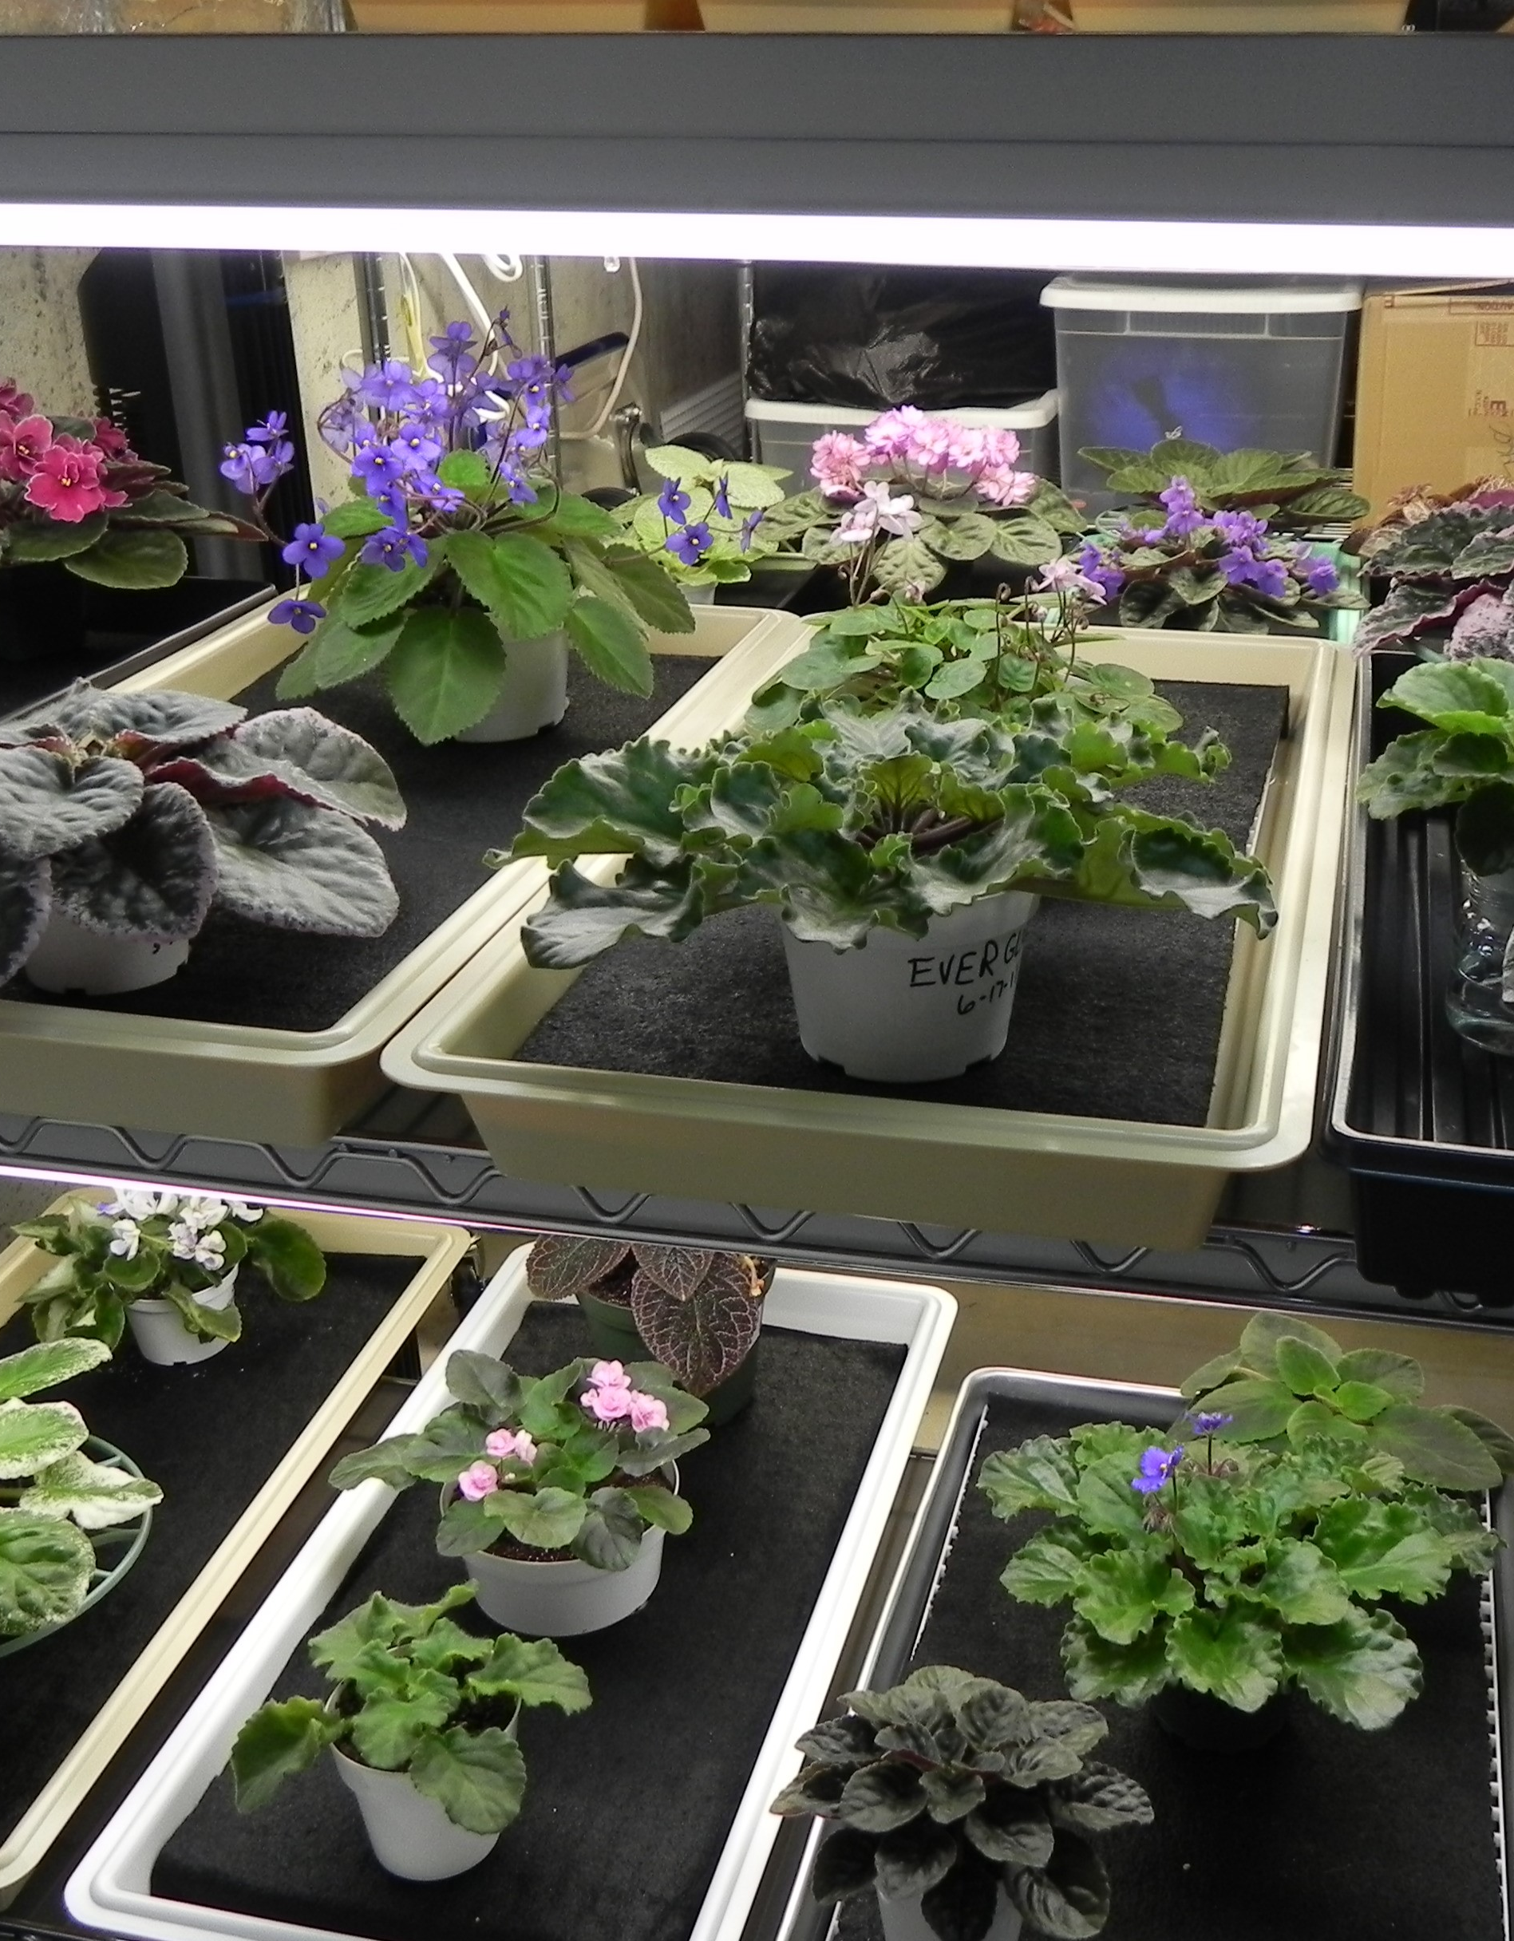
Established plant collection
My plants over the years.

Slide 11
The End Of Presentation.

