Slide 1
Growers’ Show & Tell
January 2017 Meeting
Kasey Angeloni

Slide 2
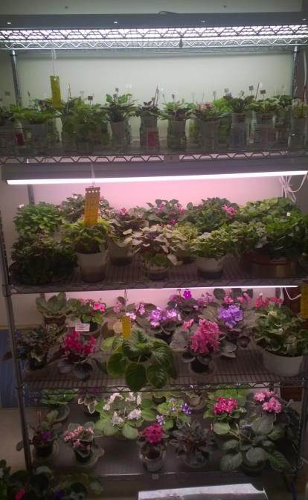
Al Cenci

Slide 3
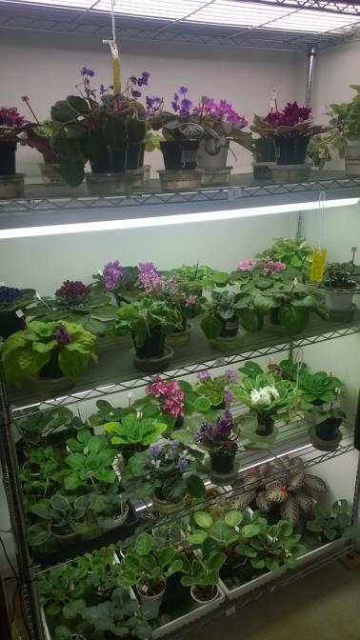
Al Cenci

Slide 4
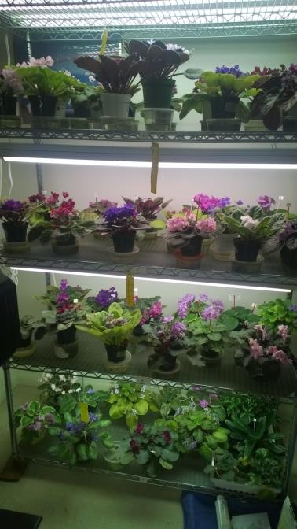
Al Cenci

Slide 5
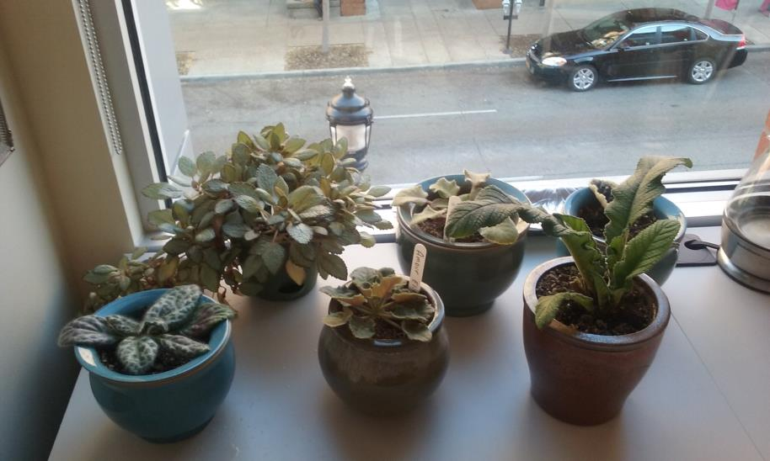
Andrea Herman

Slide 6
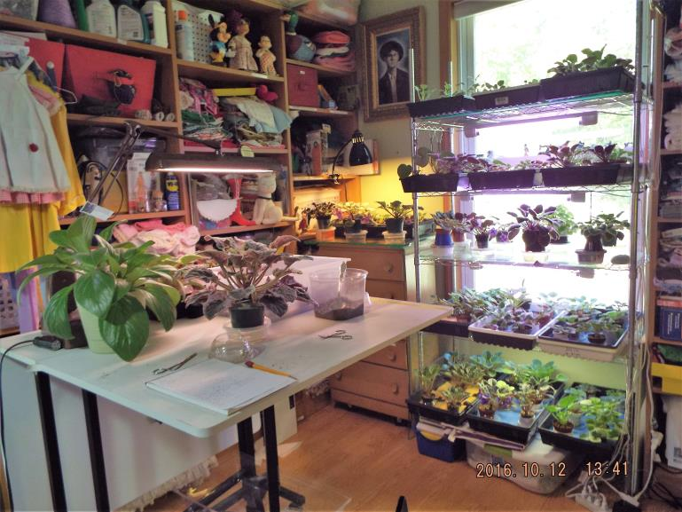
Carla Hale

Slide 7
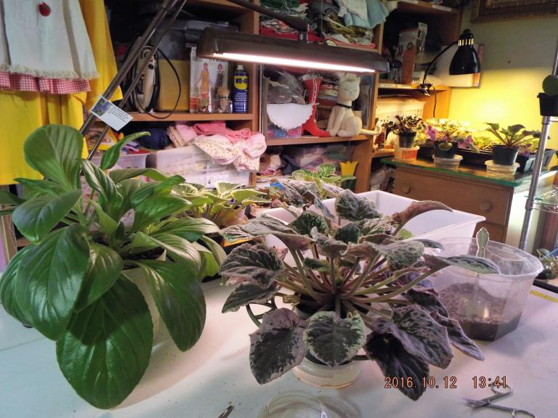
Carla Hale

Slide 8
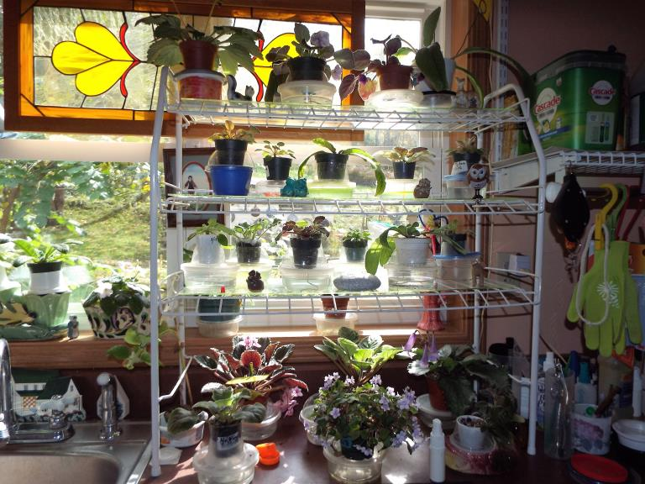
Carla Hale

Slide 9
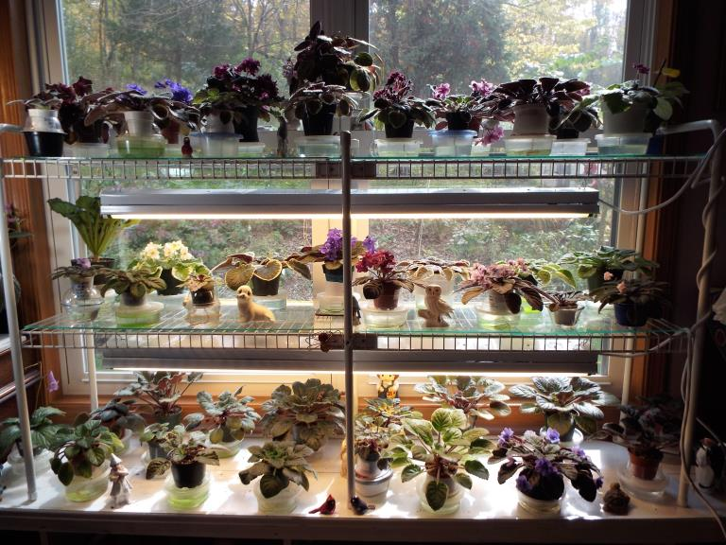
Carla Hale

Slide 10
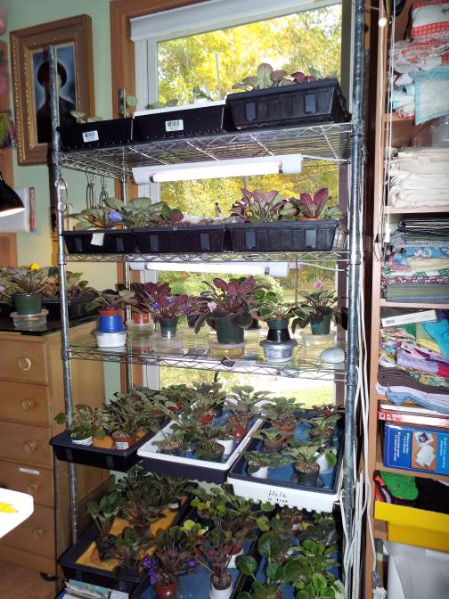
Carla Hale

Slide 11
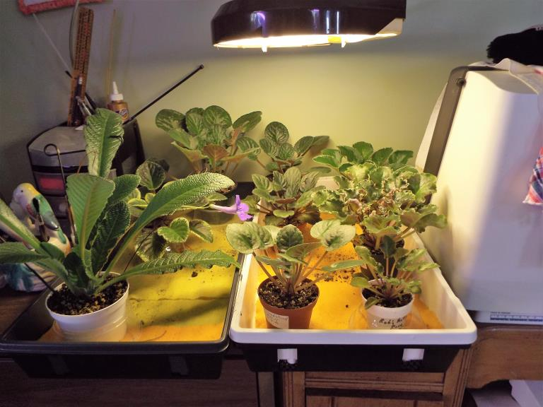
Carla Hale

Slide 12
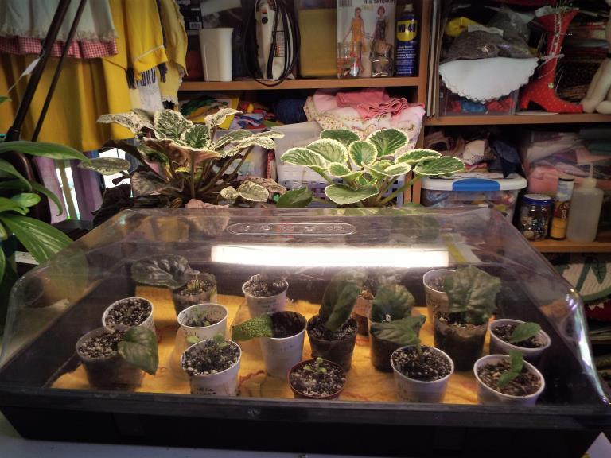
Carla Hale

Slide 13
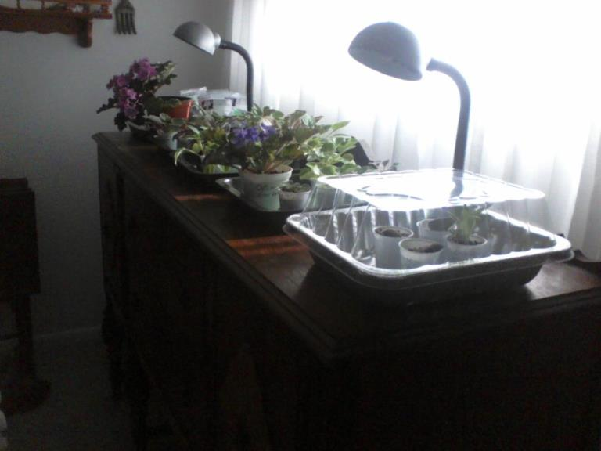
Carolyn Richardson

Slide 14
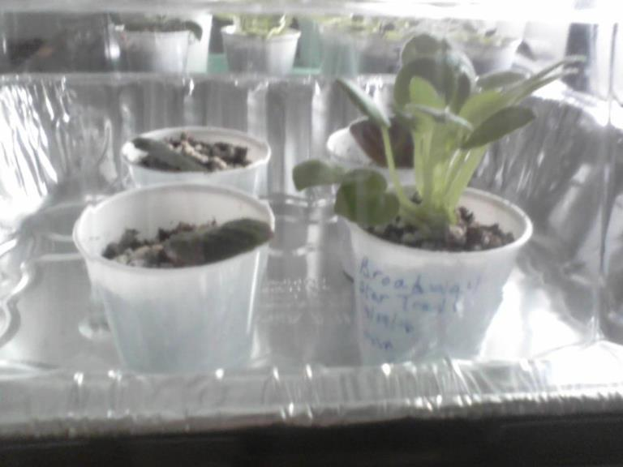
Carolyn Richardson

Slide 15
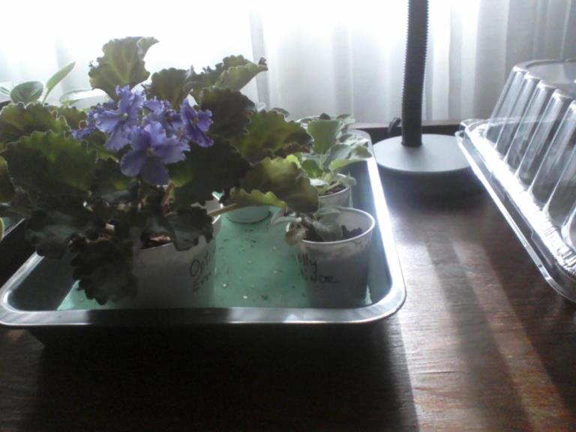
Carolyn Richardson

Slide 16
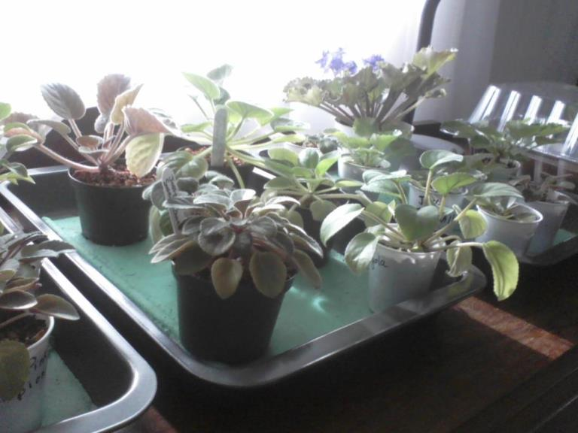
Carolyn Richardson

Slide 17
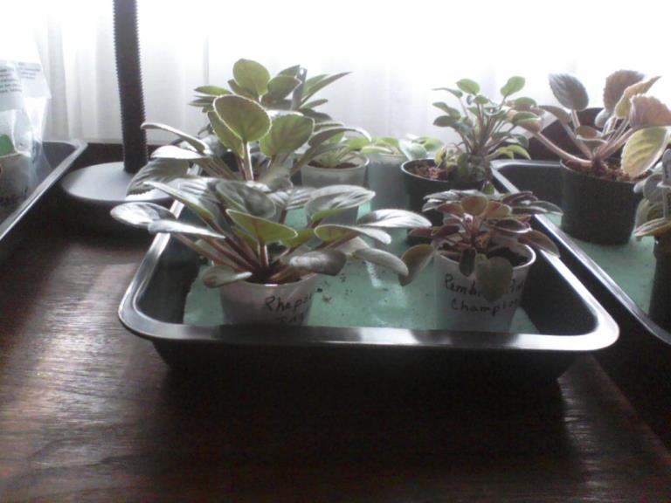
Carolyn Richardson

Slide 18
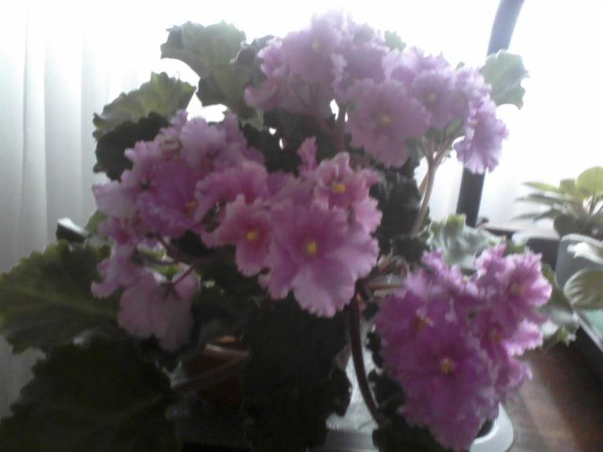
Carolyn Richardson

Slide 19
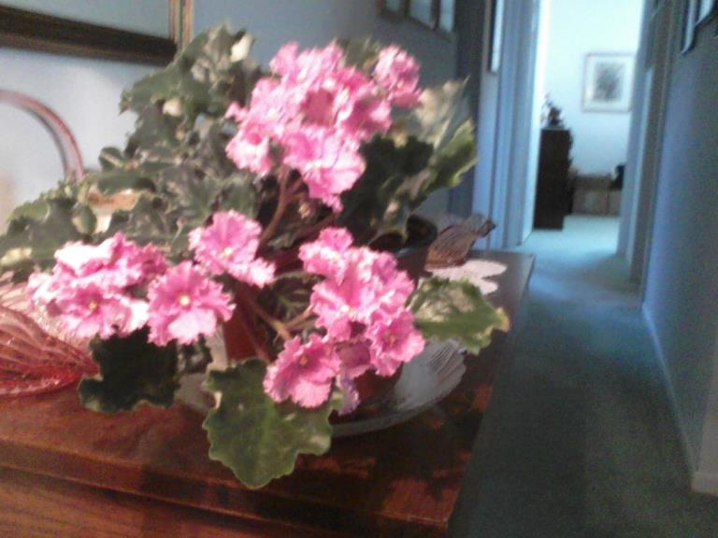
Carolyn Richardson

Slide 20
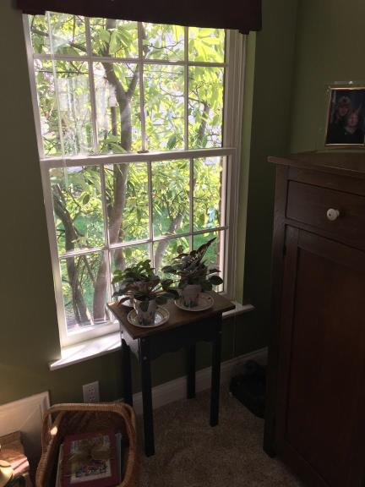
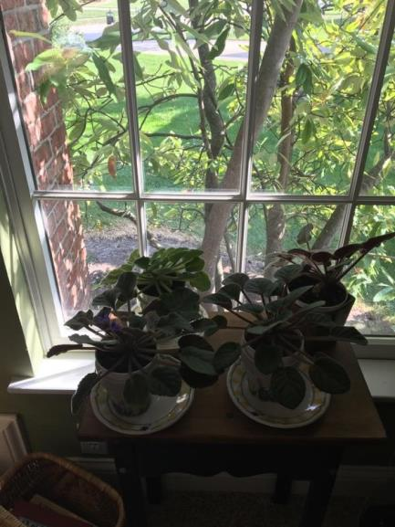
Jan DeVeny

Slide 21
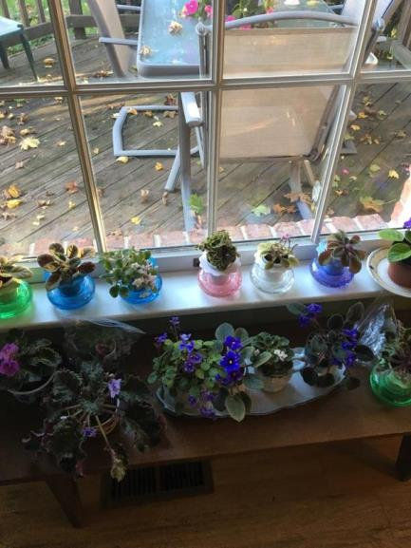
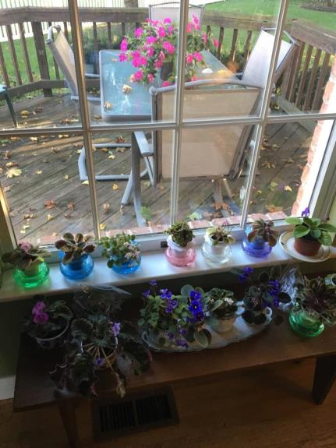
Jan DeVeny

Slide 22
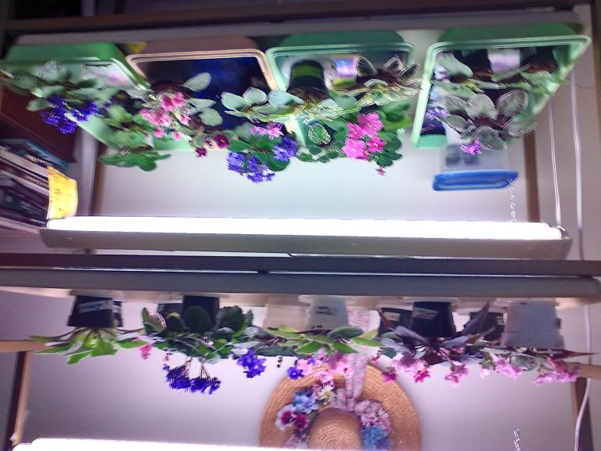
Jan Schroeder

Slide 23
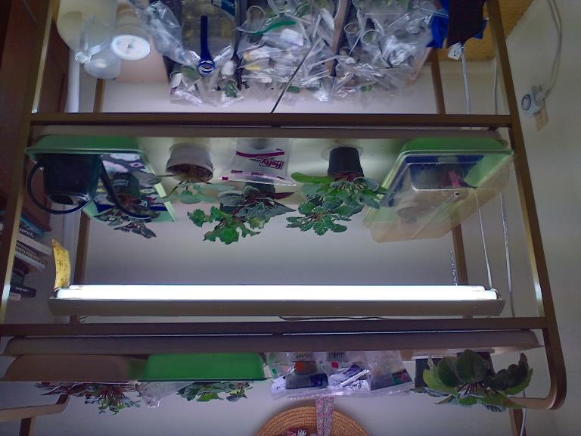
Jan Schroeder

Slide 24
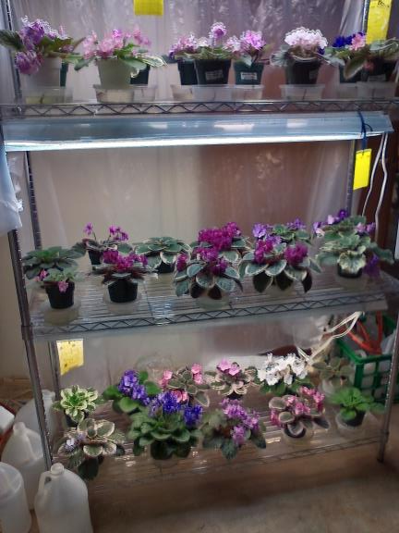
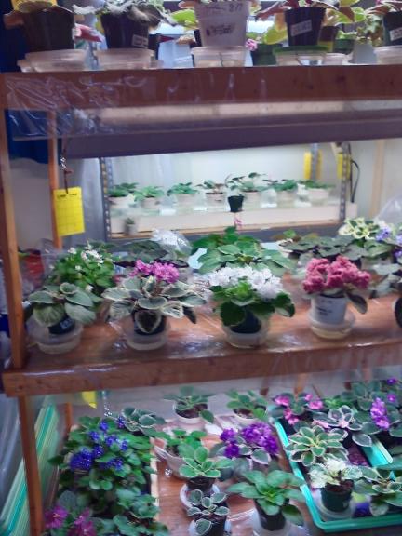
Jan Schroeder

Slide 25
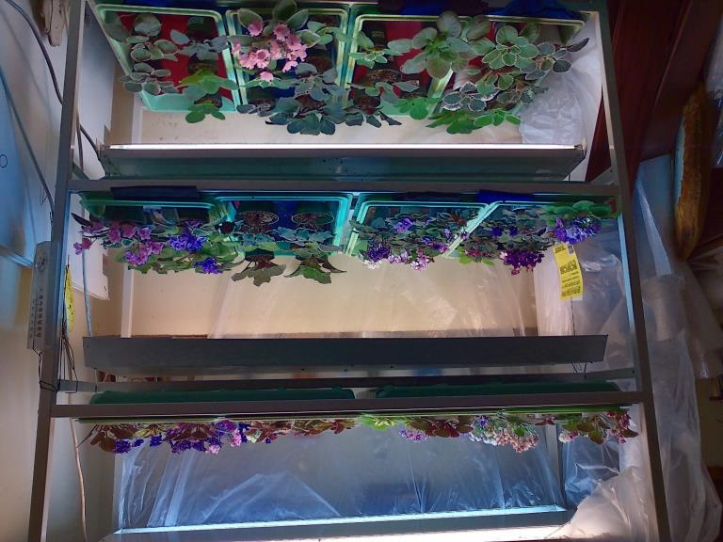
Jan Schroeder

Slide 26
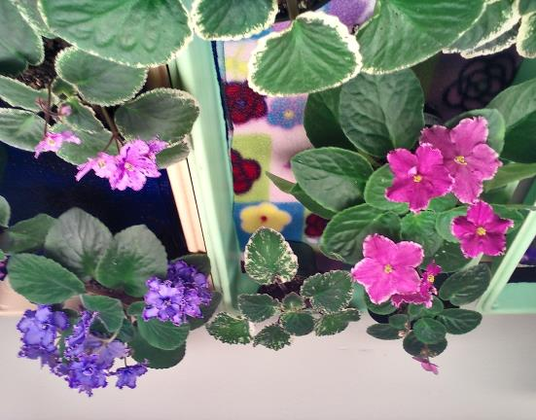
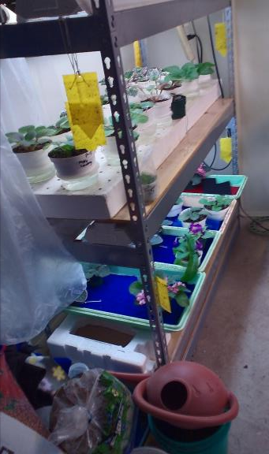
Jan Schroeder

Slide 27
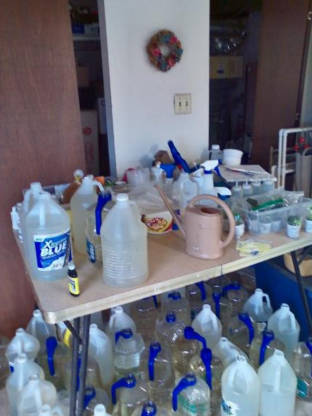
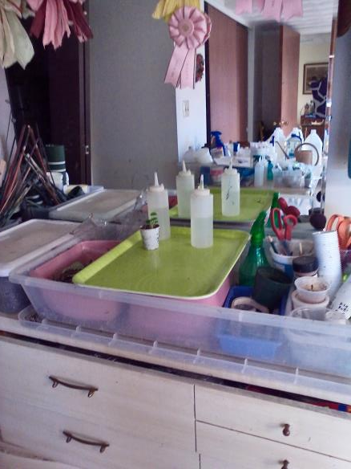
Jan Schroeder

Slide 28
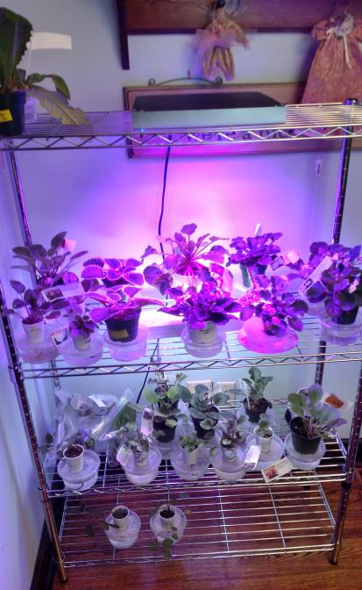
Jill Henry

Slide 29
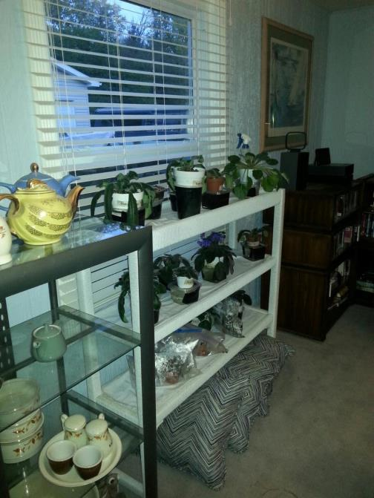
Joan Cornett

Slide 30
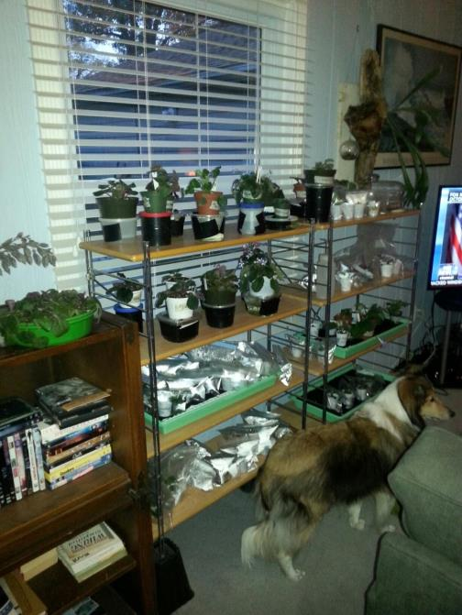
Joan Cornett

Slide 31
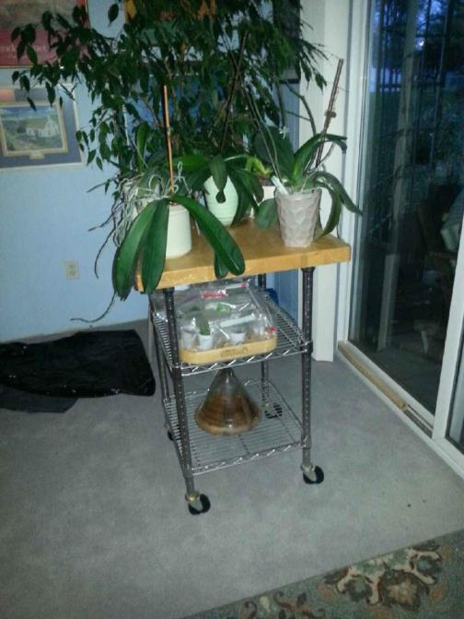
Joan Cornett

Slide 32
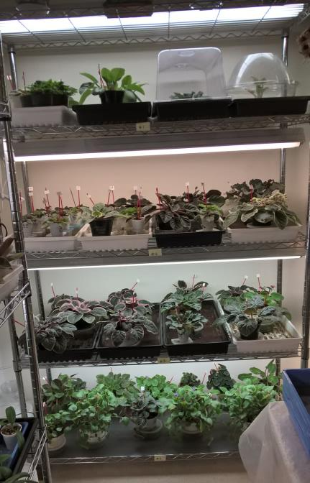
Karen Cenci

Slide 33
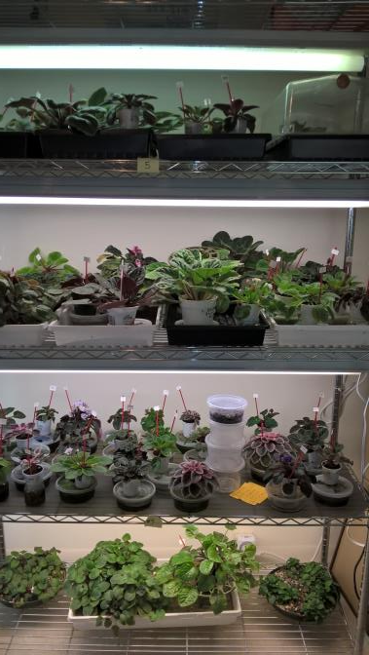
Karen Cenci

Slide 34
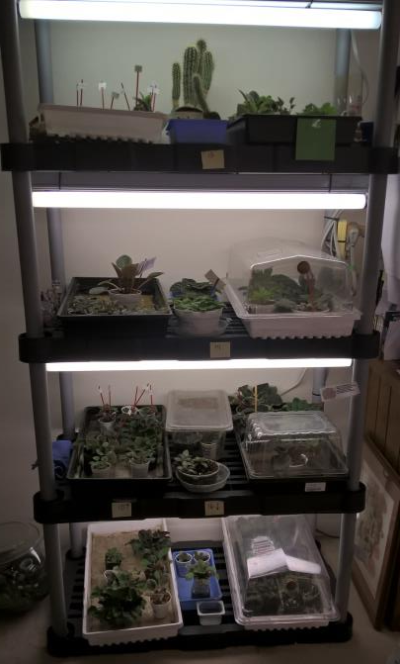
Karen Cenci

Slide 35
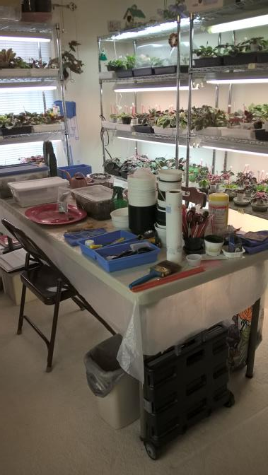
Karen Cenci

Slide 36
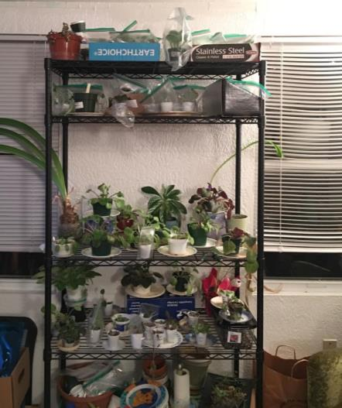
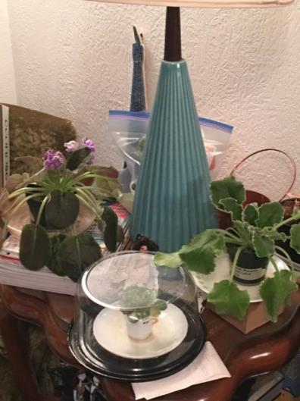
Kasey Angeloni

Slide 37
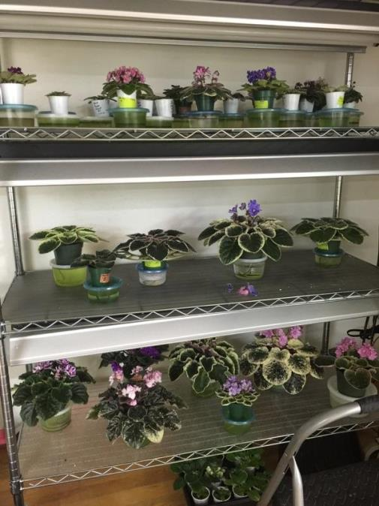
Linda Lloyd

Slide 38
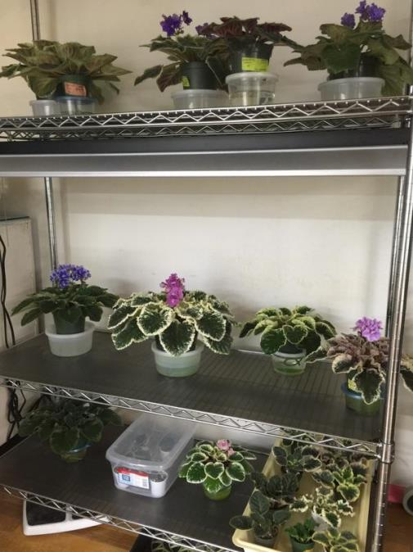
Linda Lloyd

Slide 39
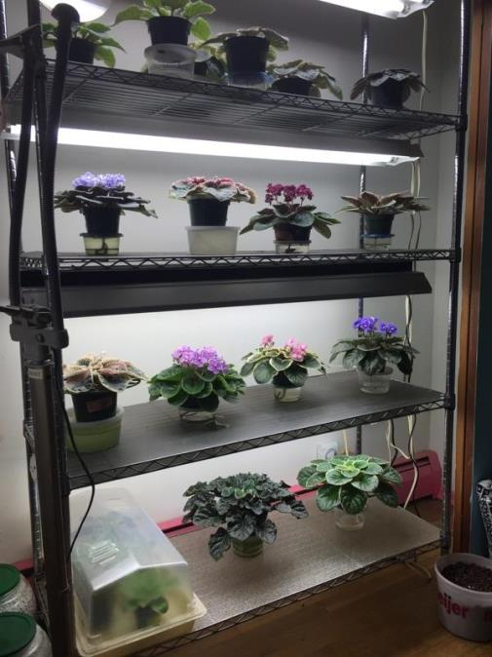
Linda Lloyd

Slide 40
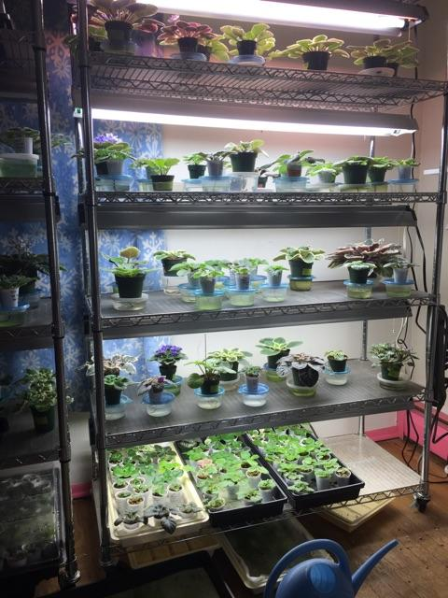
Linda Lloyd

Slide 41
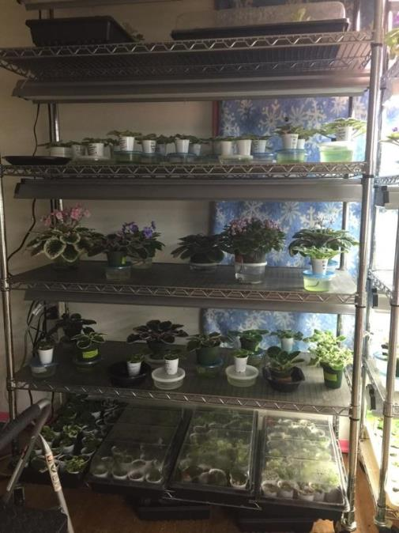
Linda Lloyd

Slide 42
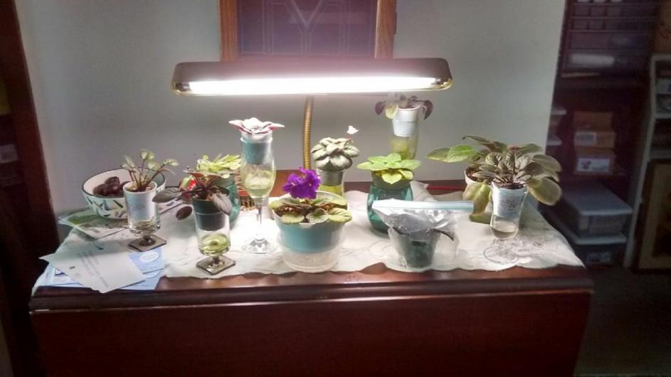
Maggie Garcia

Slide 43
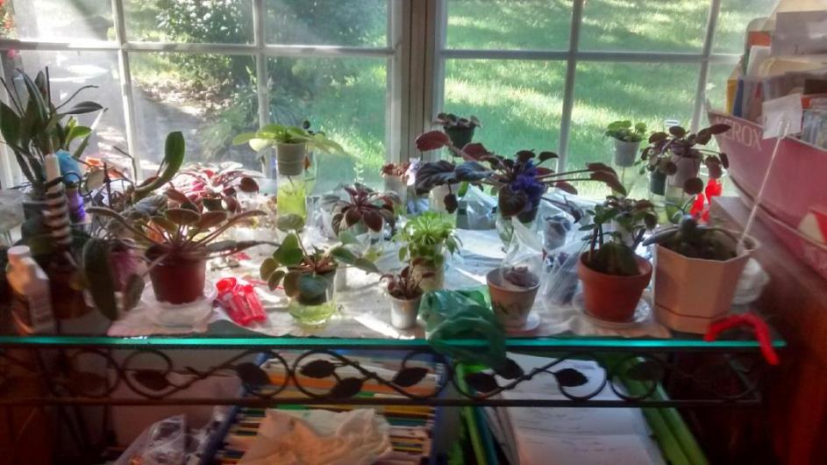
Maggie Garcia

Slide 44
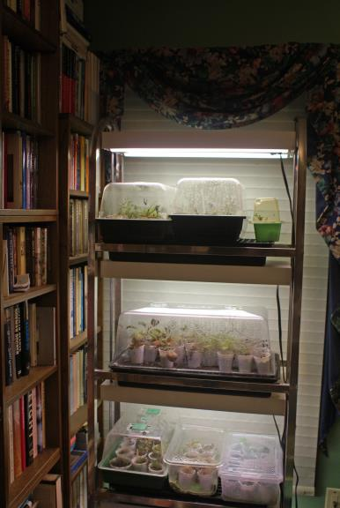
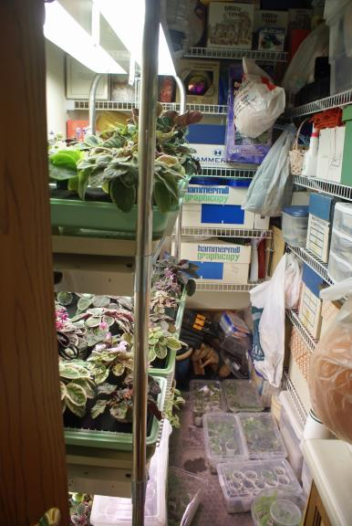
Mel Grice

Slide 45


Mel Grice

Slide 46

Mel Grice

Slide 47

Mel Grice

Slide 48

Mel Grice

Slide 49


Pat Hancock

Slide 50

Pat Hancock

Slide 51

Pat Hancock

Slide 52

Pat Hancock

Slide 53

Pat Hancock

Slide 54

Shirley Jones

Slide 55

Shirley Jones

Slide 56

Shirley Jones

Slide 57


Shirley Jones

Slide 58


Susie Yu

Slide 59


Vicki Ferguson

Slide 60

Vicki Ferguson

Slide 61
THANK YOU!!!

